Slide 1
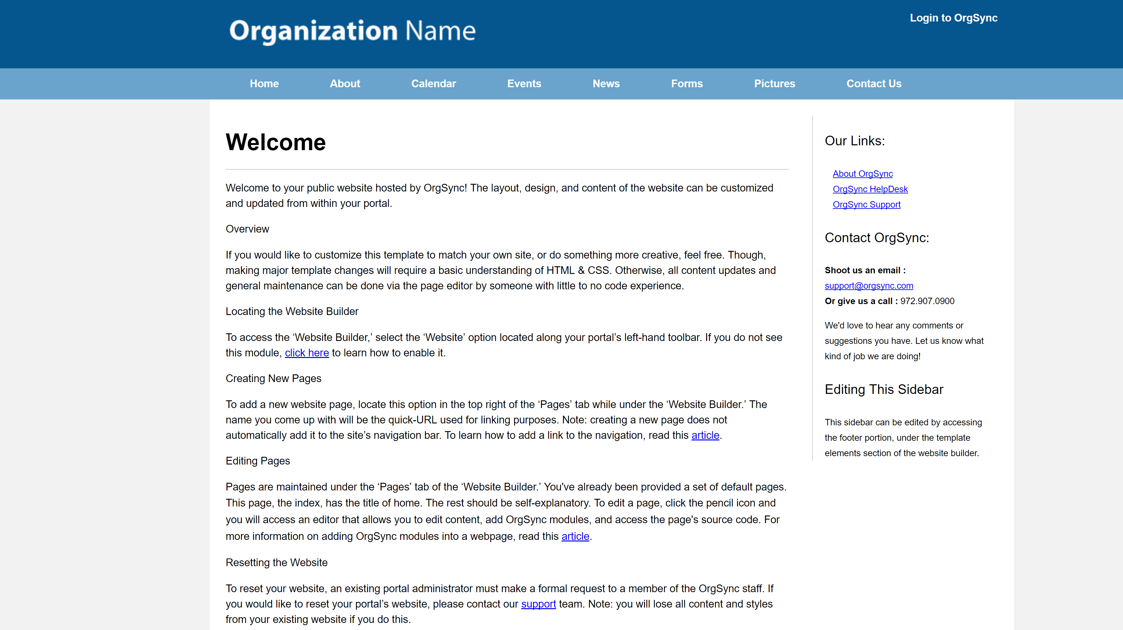
Go from this…

Slide 2
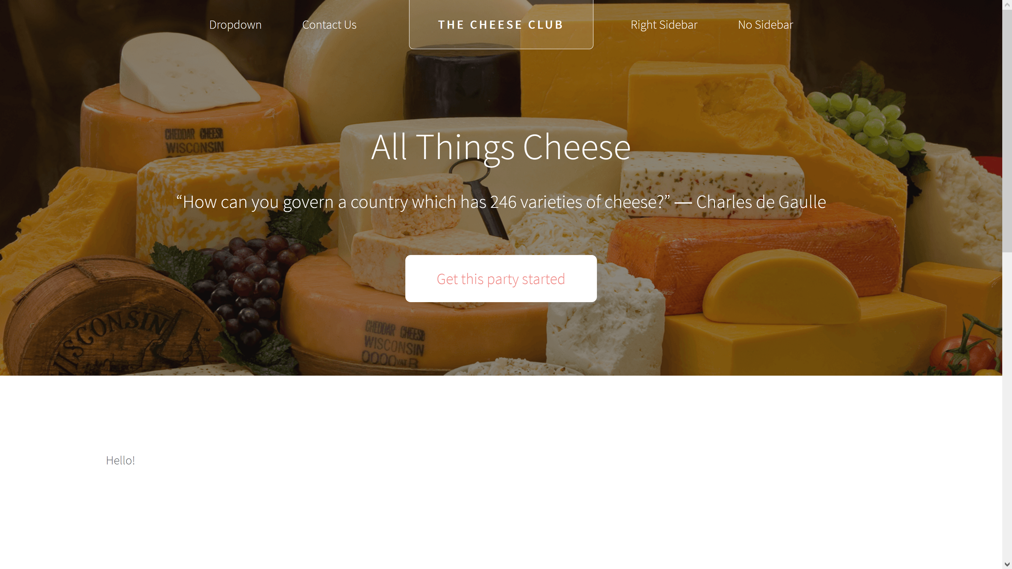
To this!

Slide 3
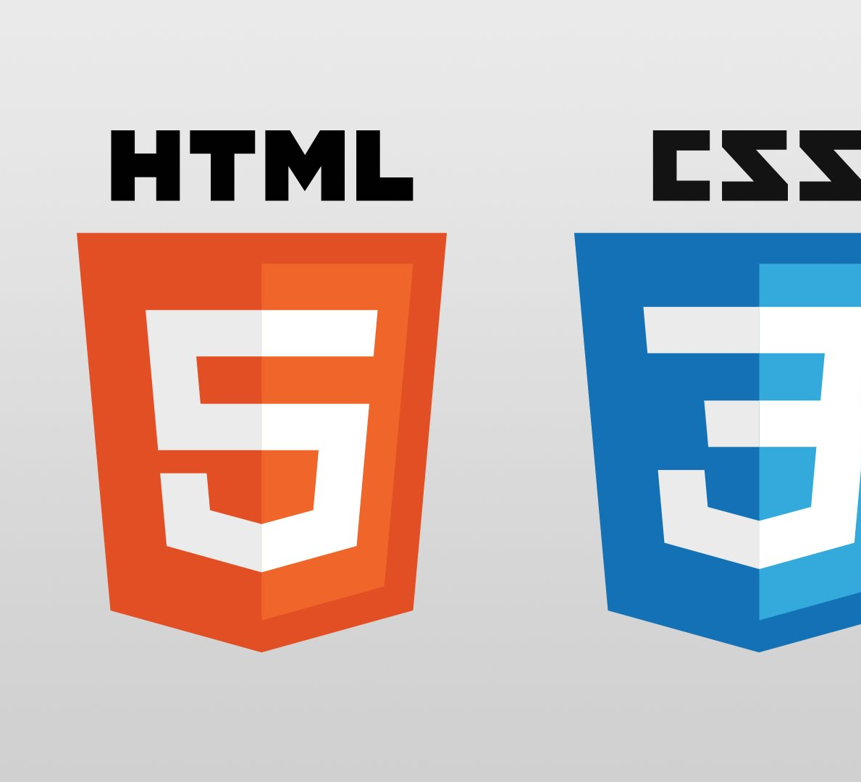
Before we begin…
HTML Basics
The ‘Skeleton’
Meta/Head
Header
Body
Footer
CSS Basics
The ‘Skin’
Fonts, colors, size

Slide 4
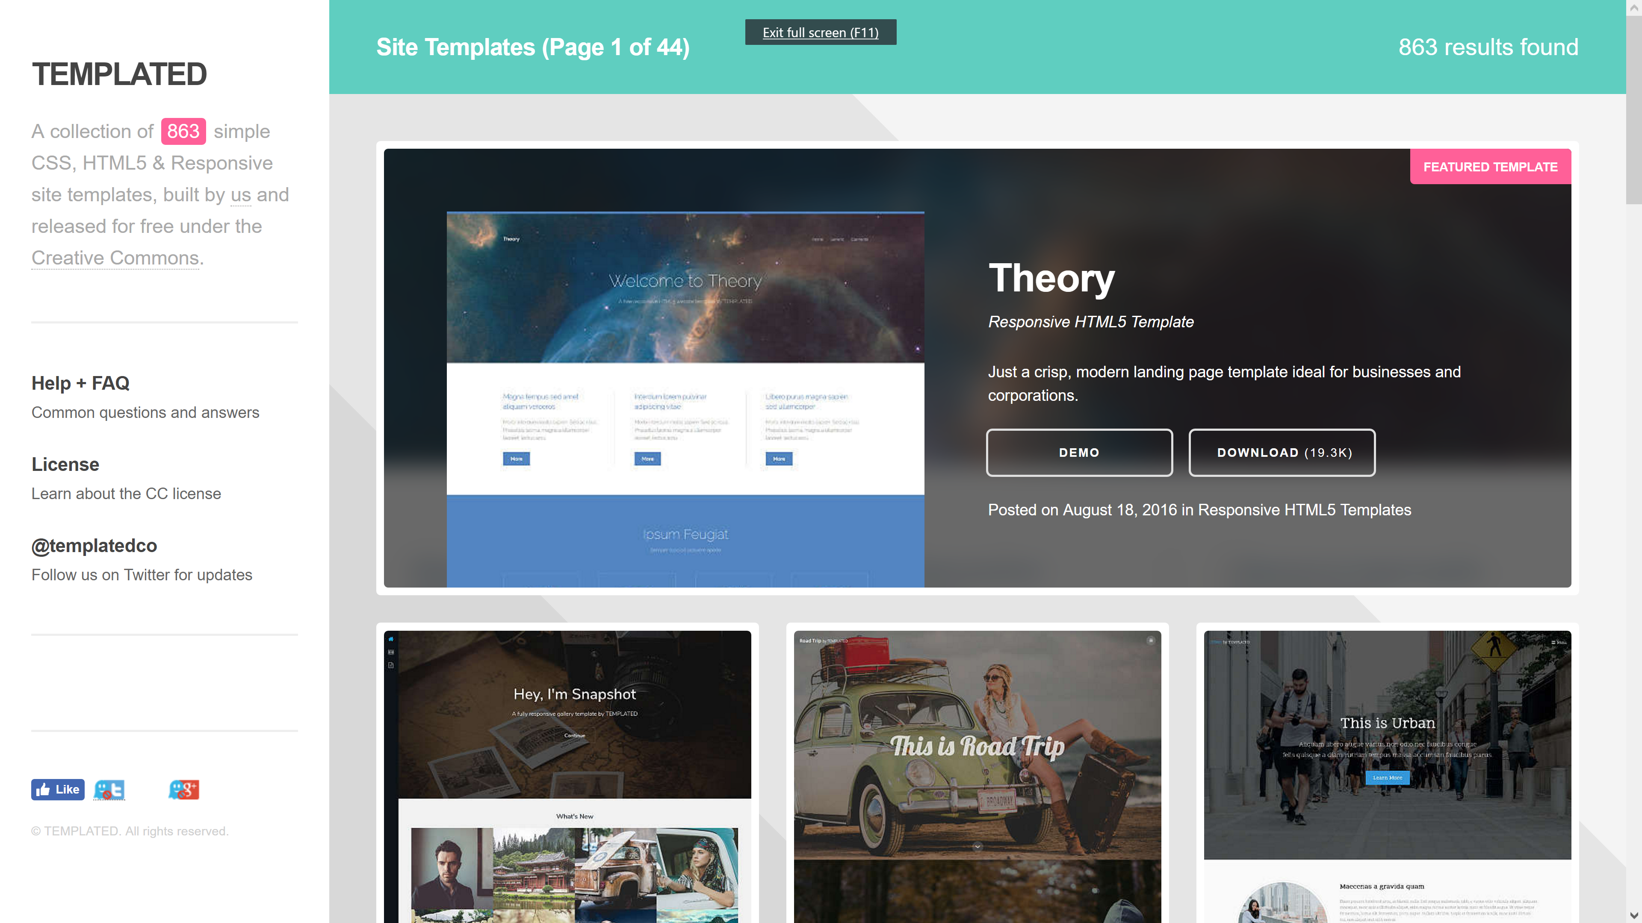
Step 1: Find a template
https://templated.co, https://html5up.net
Keywords: Responsive, HTML5, FREE
Function over form

Slide 5
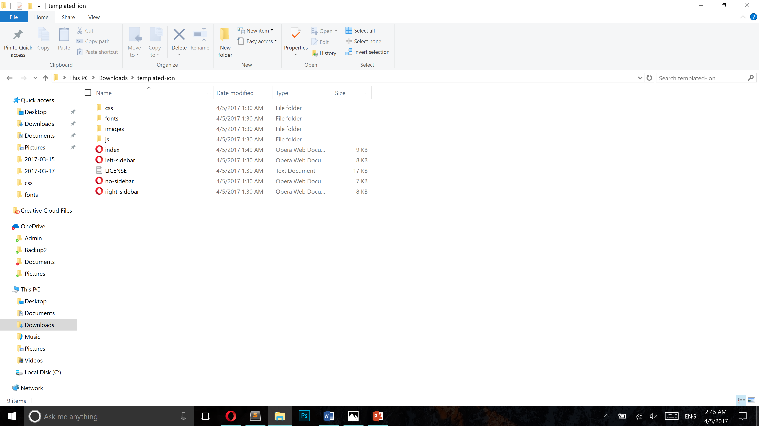
Step 2: Break Down the Package
CSS
Fonts
Images
Javascript
HTML (usually ‘index.html’)

Slide 6
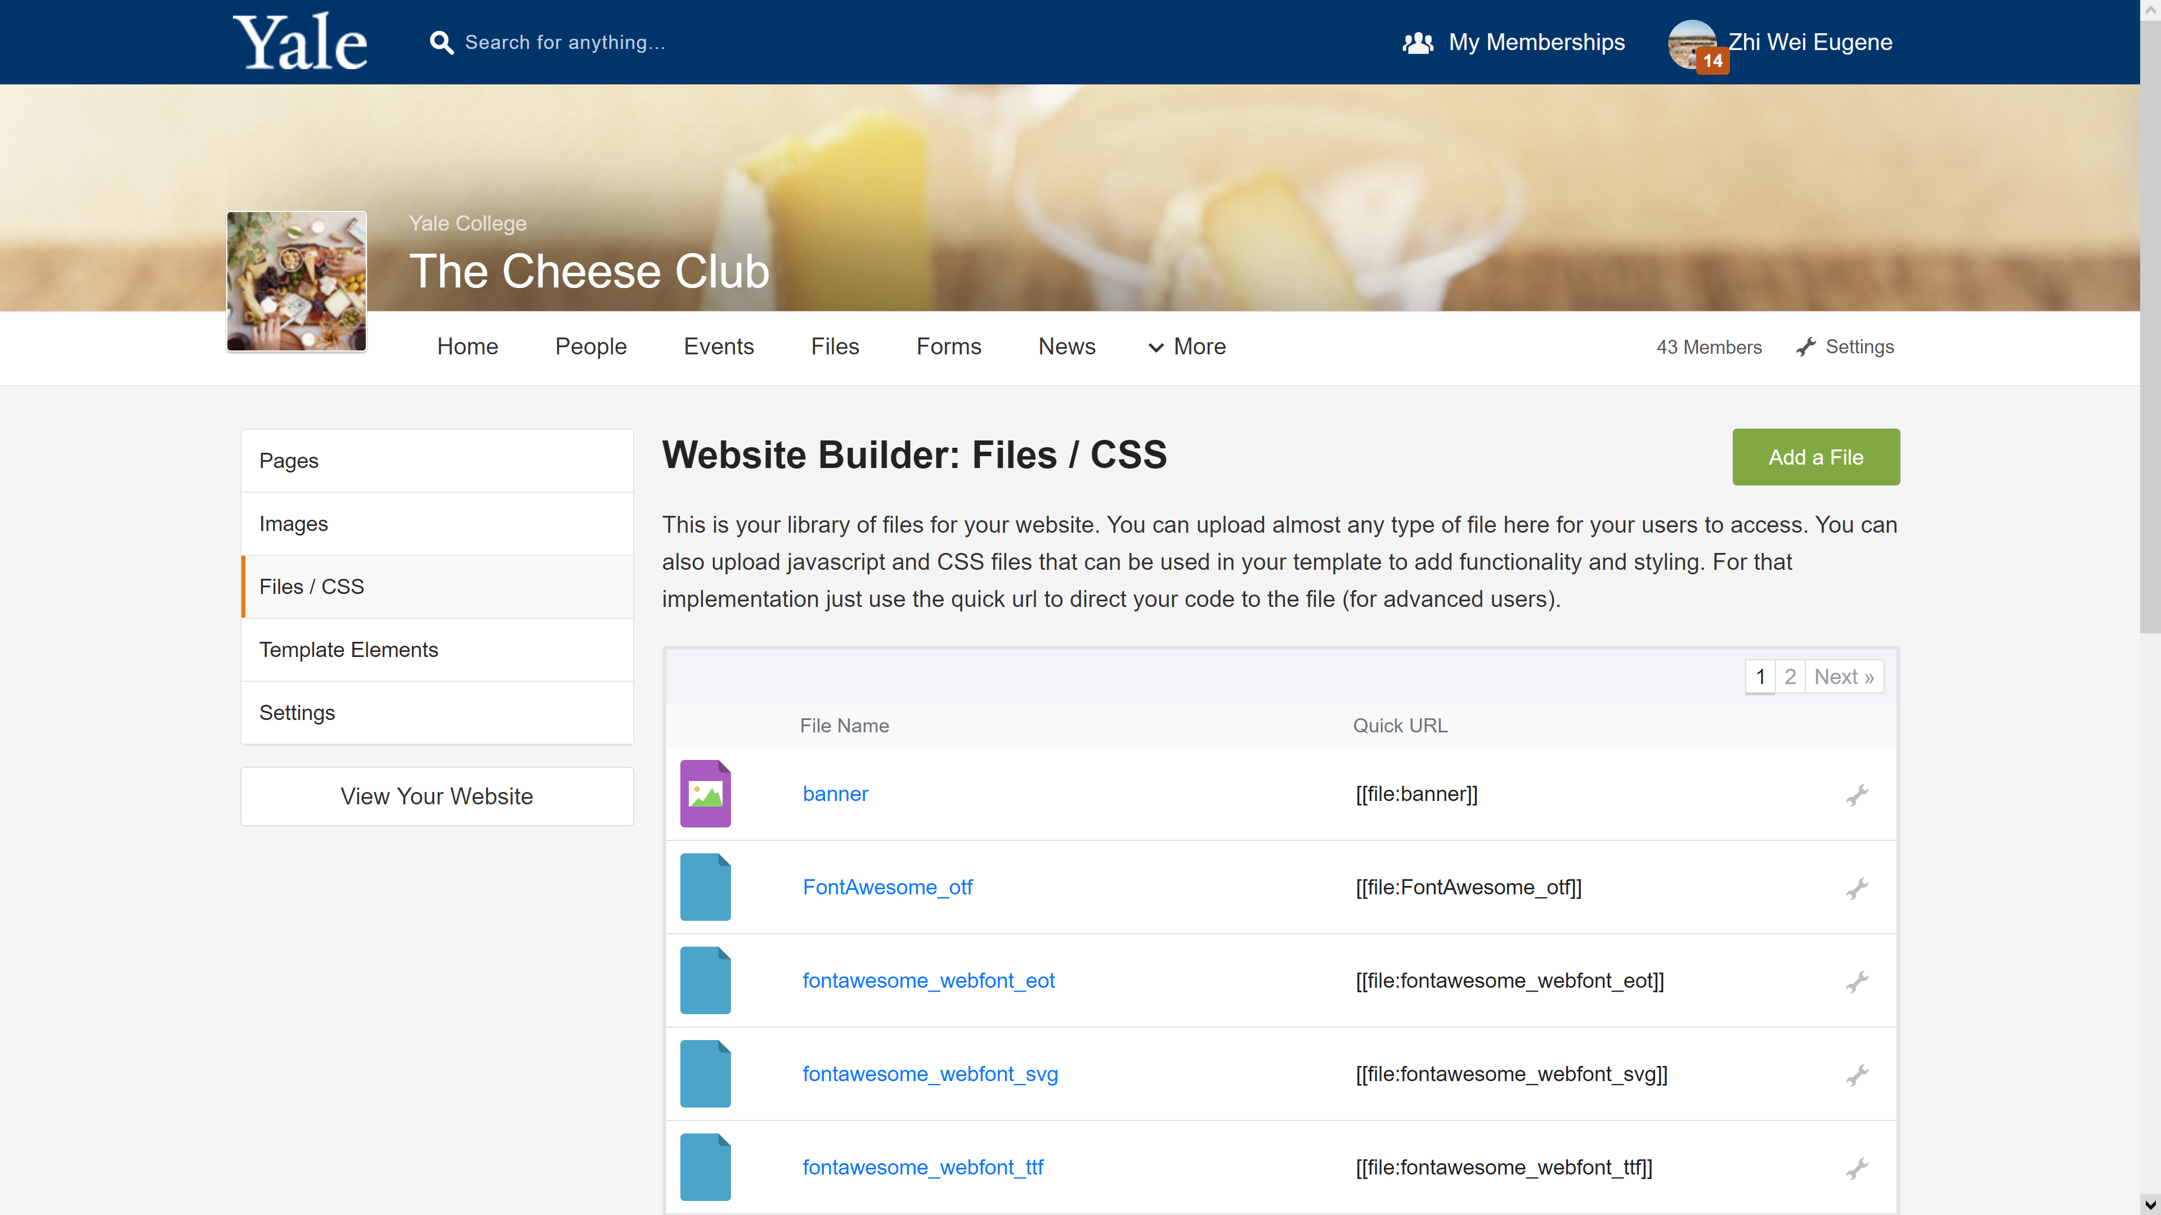
Step 3: Upload Resources Files
Fonts
Images
Javascript

Slide 7
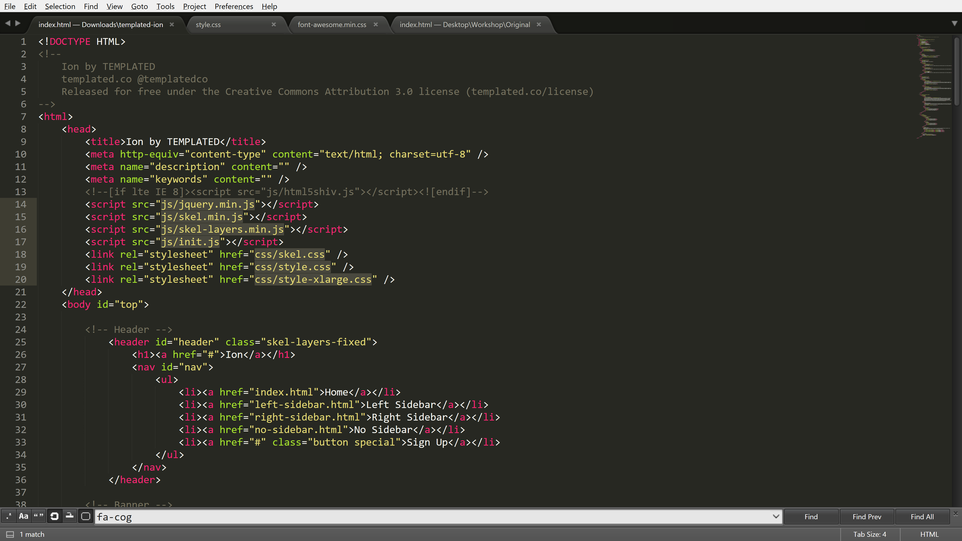
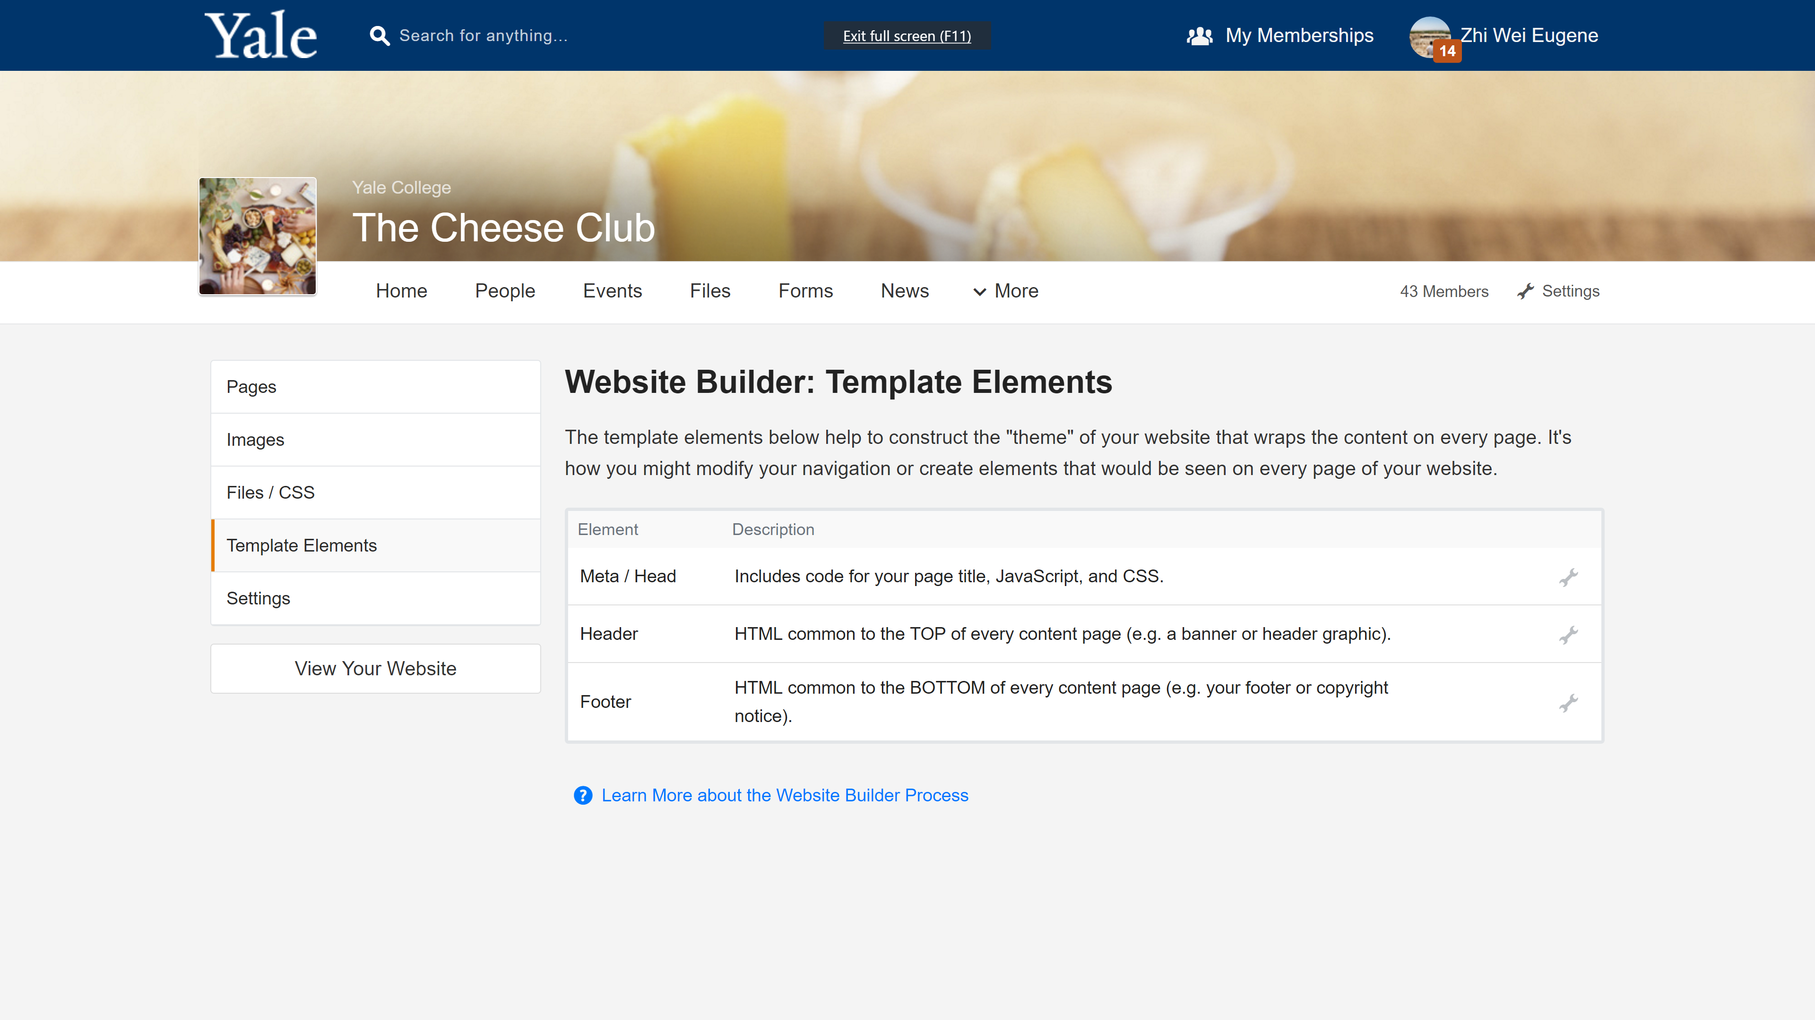
Step 4: Update and Upload CSS/HTML
Fill in blank URLs
Use Orgsync Shortcuts [[file:FILENAME]]
Add Orgsync default files
[[file:orgsync_defaults]]
CSS before HTML

Slide 8
Step 5: Break up and Add HTML
Goes into Template Elements
Head
Header
Footer
Goes into Pages source
Body

Slide 9
Step 6: Debug and add your own content
WYSIWYG editor
Body templates
Orgsync modules

